Slide 1

Computer Network
Computer Network System: Analysis, Design, Implementation, and Maintenance

Slide 2
Objectives
What is a Computer Network System?
Benefits of Network Systems
Steps to design the LAN network, MAN network.

Slide 3
What is a Computer Network System?
A group of interconnected devices
Enables data sharing, communication, and resource access
Used in organizations, homes, and institutions

Slide 4
Benefits of Network Systems
- Centralized data management
- Efficient communication (emails, VoIP)
- Shared hardware (printers, storage)
- Scalable and flexible infrastructure

Slide 5
Network Requirements Analysis
- Determine organizational goals and budget
- Estimate number of users and devices
- Evaluate current infrastructure
- Define security and performance needs

Slide 6
Network Design Phase
- Select topology (Star, Bus, Mesh, Hybrid)
- Choose appropriate hardware (routers, switches, etc.)
- Plan IP addressing and subnetting
- Develop security strategies (firewalls, VLANs)

Slide 7
Network Design Phase
- Router: Directs data between networks
- Switch: Connects devices within the same network
- Firewall: Filters incoming/outgoing traffic
- Access Point: Wireless connectivity

Slide 8
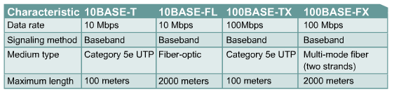
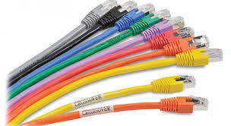
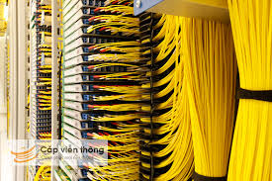
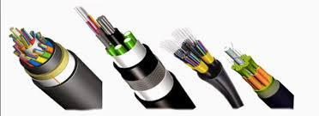
Network Design Phase
Design: Physical

Slide 9

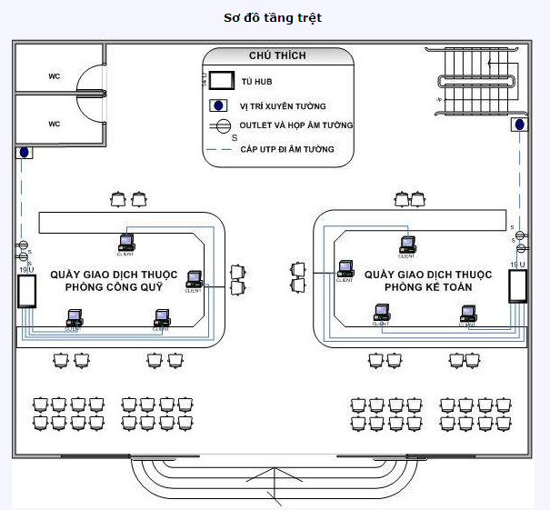
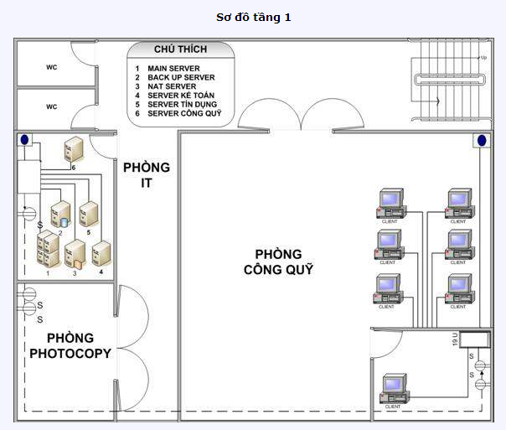
Network Design Phase

Slide 10
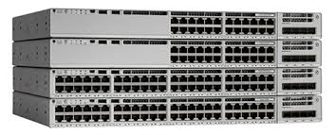
Network Design Phase
Design: Data link
Chose Switch: Cisco, Juniper,….
Catalyst 1900 series
Catalyst 2820 series
Catalyst 2950 series
Catalyst 4000 series
Catalyst 5000 series

Slide 11
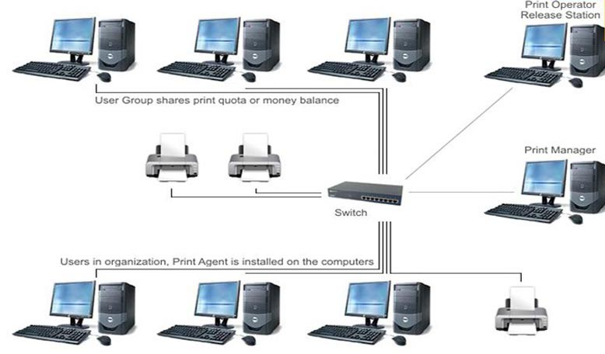
Network Design Phase
Design: Data link

Slide 12
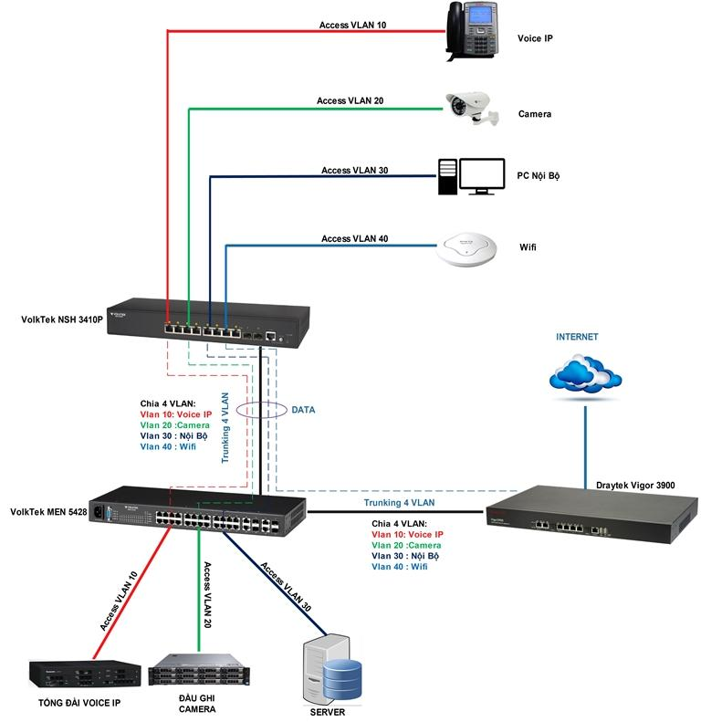
Network Design Phase
Design: Data link

Slide 13
Network Implementation
- Install physical components (cables, racks)
- Configure routers and switches
- Deploy network services (DHCP, DNS)
- Set up wireless access and security

Slide 14
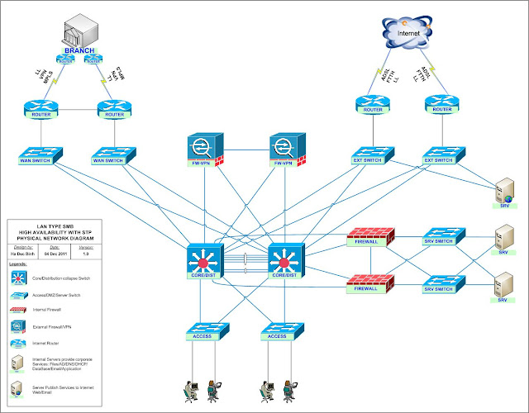
Network Design Phase
Design: Network

Slide 15
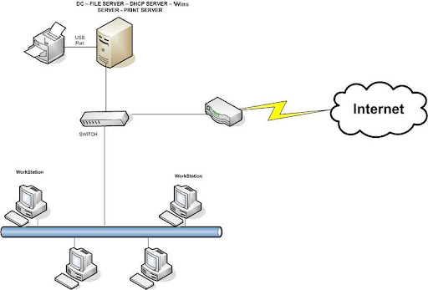
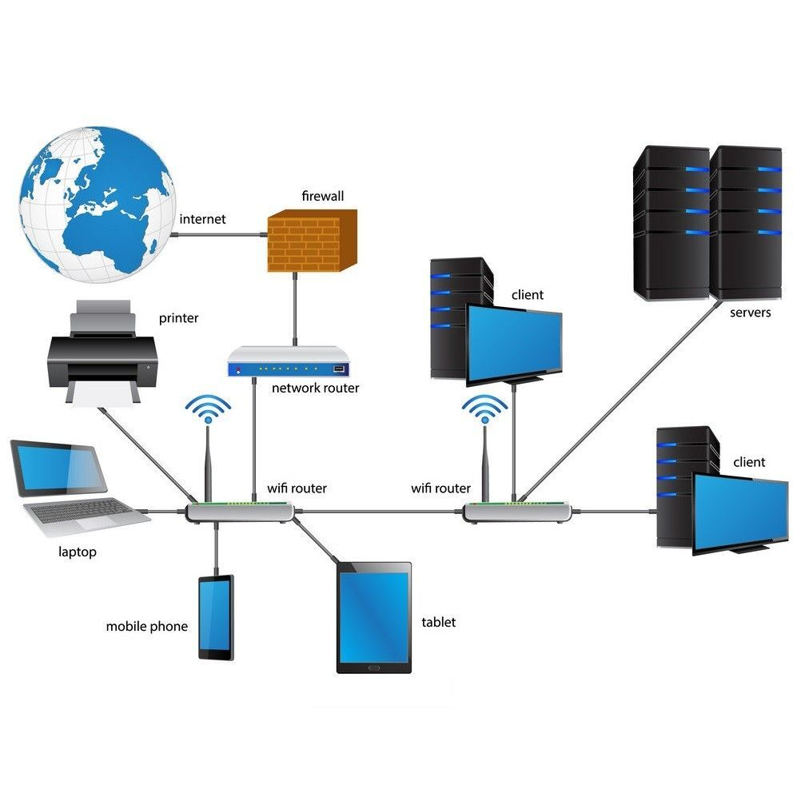
Some Network Systems

Slide 16
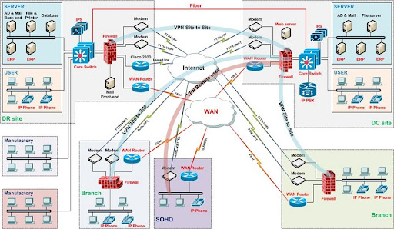
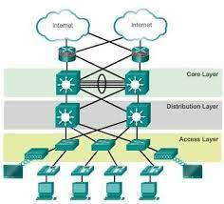
Some Network Systems

Slide 17
Testing
- Connectivity testing (ping, traceroute)
- Security testing (penetration tests)
- Performance benchmarking
- Documentation of results

Slide 18
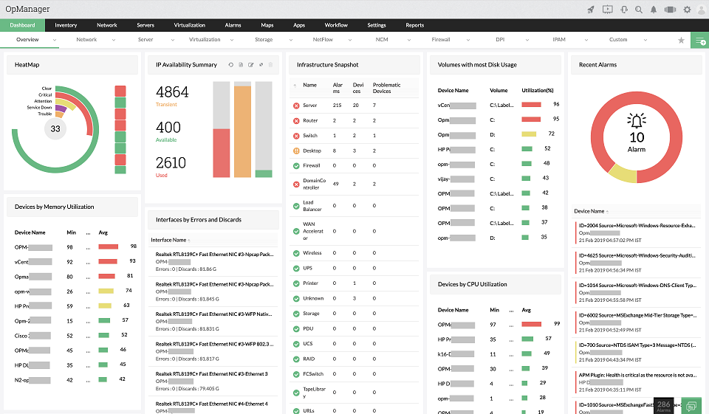
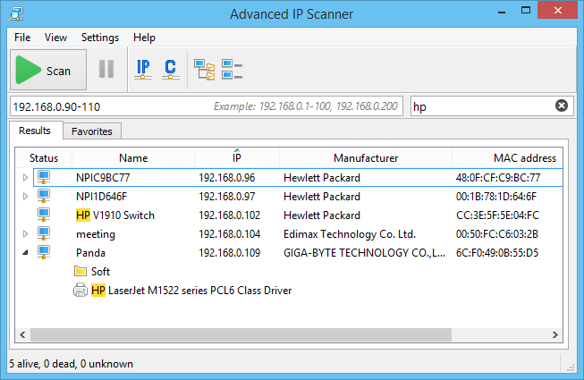
Network Maintenance
- Monitor network traffic and performance
- Apply firmware and software updates
- Backup and disaster recovery planning
- Respond to incidents and troubleshoot issues

Slide 19
Future Expansion and Scalability
- Modular design for future upgrades
- Virtualization and cloud integration
- Support for IoT and edge devices
- Capacity planning

Slide 20
DESIGN NETWORK SYSTEM
ABC Company has approximately 300 computers and one leased-line connection. The company wants to build a website and a mail server to meet its internal needs. What do you need to do so that the clients in the company can access data, send and receive emails, and access the internet? Draw a diagram and outline the steps to build a complete network system.
Company ABC has two branches, each with about 300 computers. The company wants to build a network system so that these two branches can exchange data. What do you need to do so that clients throughout the company can access the data? Draw an illustration and describe the steps to build a complete network system.
Chương 2

Slide 21
DESIGN NETWORK SYSTEM
3. Design a wireless network across 3 floors to support access for 300 students.
Chương 2

Slide 22
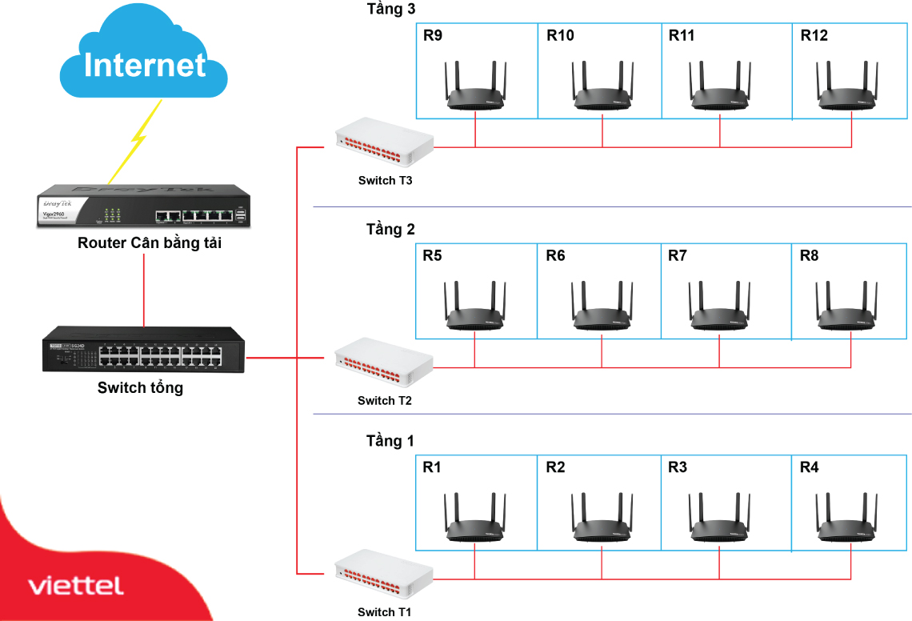
Thiết kế hệ thống mạng
Bài tập.
3. Design a wireless network across 4 floors to support access for 1,000 students.
Chương 2

